Slide 1
Berlin Airbnb Ratings and Reviews Overview
Mid_Term Project Valerio Adragna for Ironhack - September 2023
Data Source taken from Andy Kriebel https://data.world/makeovermonday/2019w25 through https://www.kaggle.com/datasets/thedevastator/berlin-airbnb-ratings-and-reviews-overview

Slide 2
Data & Questions
From the data, is it possible to draw a basic sentiment analysis of all reviews in AirBnB for Berlin?
Does the sentiment analysis and the overall scores and specific scores match: does the “linguistic score” and the numerical score match?
How do reviews for best rated properties in AirBnB differ from least rated? How big are they differentiated?
Is there a significant variation through the Berlin Districts/Macro-zones?

Slide 3
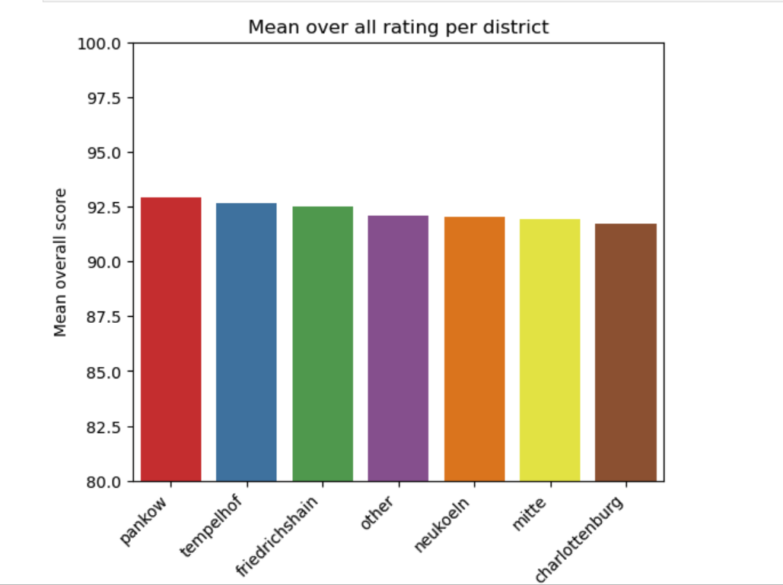
District Variation: Overall score
Pankow: 92.9
Tempelhof: 92.7
Friedrichshain: 92.5
Other: 92.1
Neukoeln: 92.0
Mitte: 91.9
Charlottenburg: 91.7

Slide 4
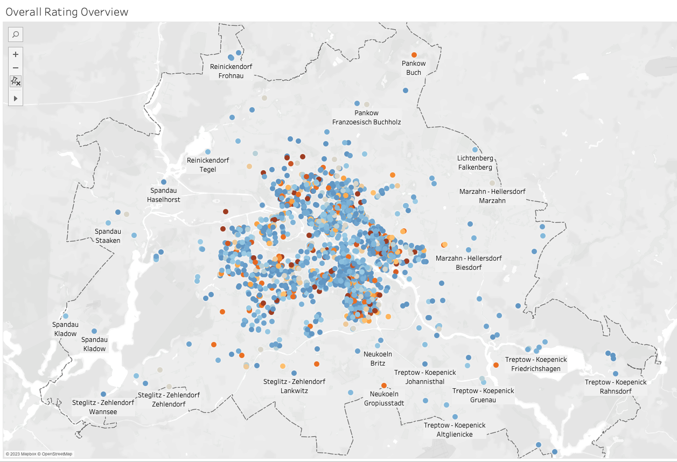

Data Insights

Slide 5
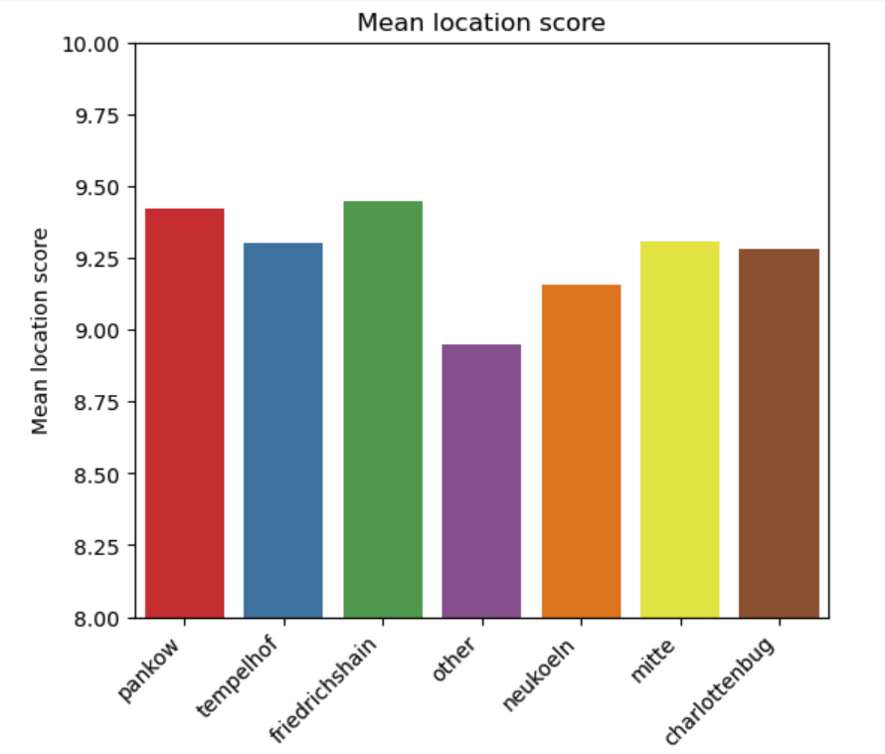
District Variation: Does this depend on the location itself?
Pankow: 9.42
Tempelhof: 9.30
Friedrichshain: 9.45
Other: 8.95
Neukoeln: 9.16
Mitte: 9.31
Charlottenburg: 9.28

Slide 6
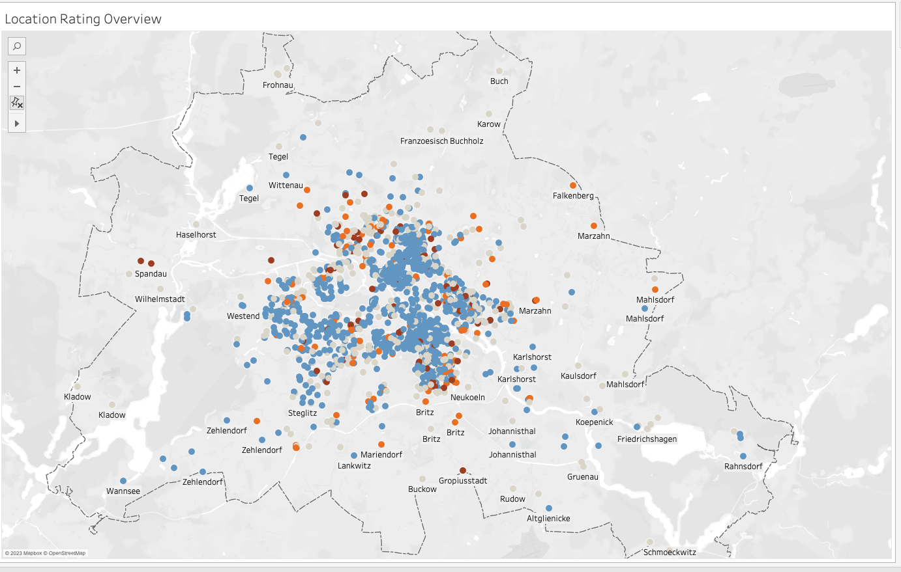


Slide 7
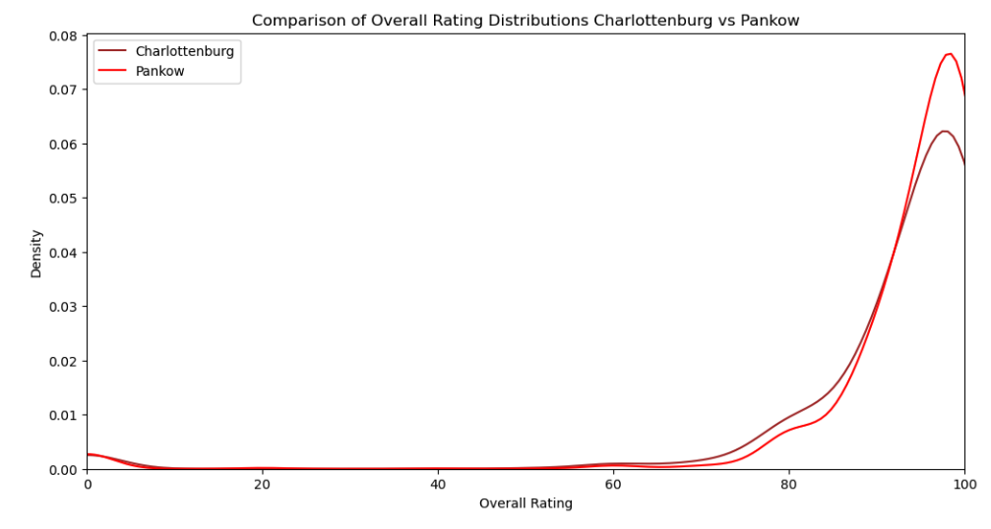
District Variation: Overall score - Best vs Charlottenburg

Slide 8
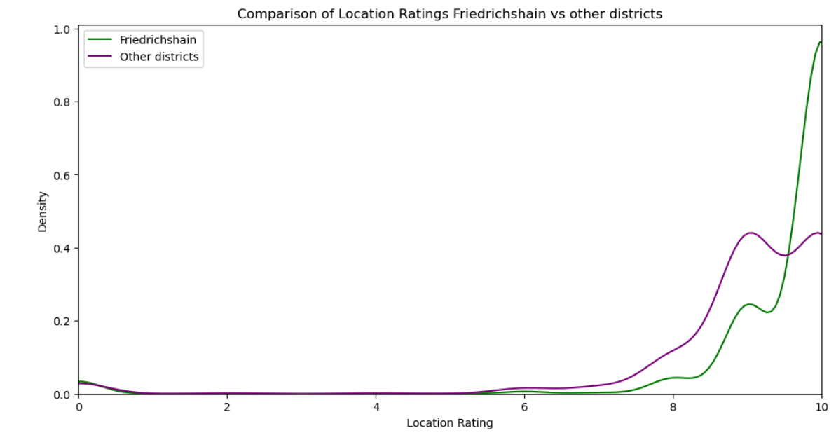
District Variation: Location Score - Best vs Worst

Slide 9
Question
Why is Mitte not performing well as expected? May price play a role?
We tend to think that an accommodation in Mitte costs on average at least 10% more than in the other districts. According to our data this hypothesis cannot be rejected.

Slide 10
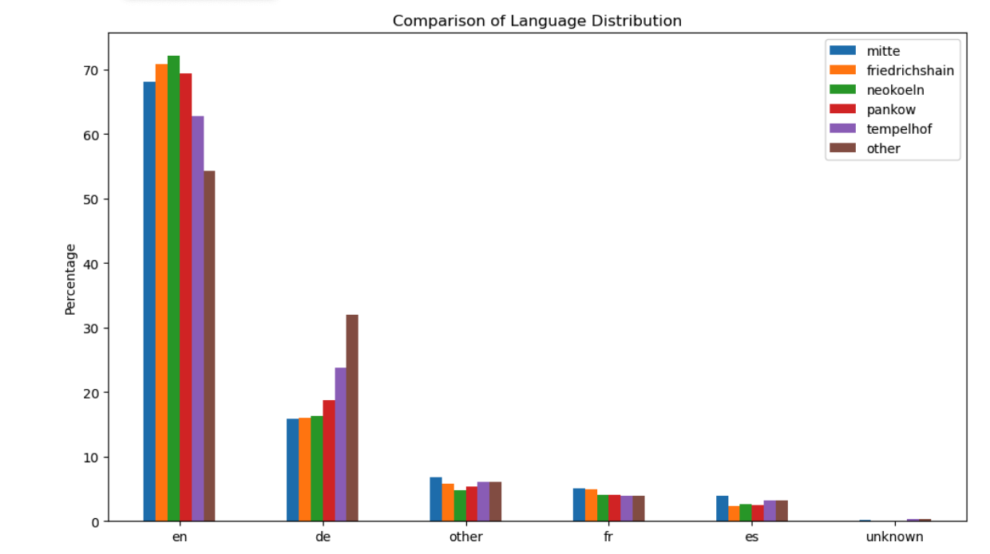
Are foreign tourists equally distributed?
Notes:
Langdetect

Slide 11
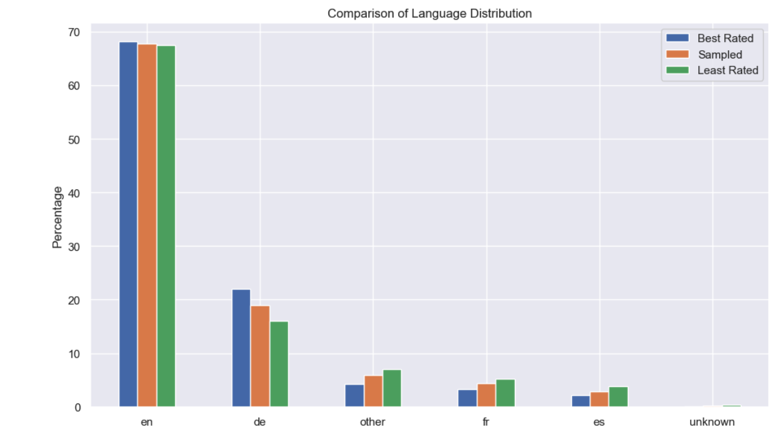
Linguistic Analysis - Variation language vs Score?

Slide 12
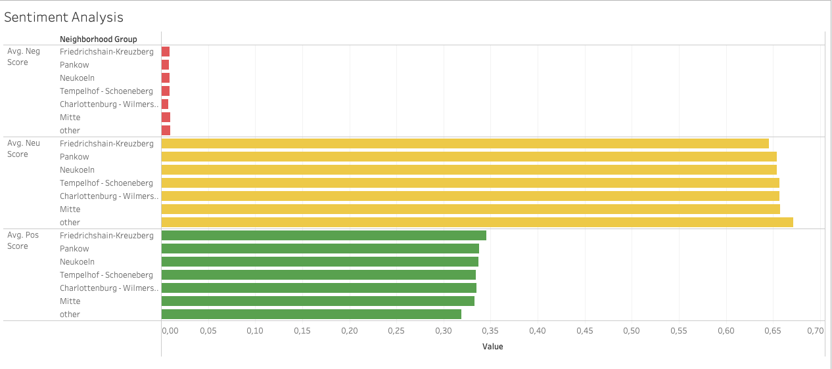
Is the numerical score conveyed through the comment?
Overall Score
Pankow: 92.9
Tempelhof: 92.7
Friedrichshain: 92.5
Other: 92.1
Neukoeln: 92.0
Mitte: 91.9
Charlottenburg:91.7

Slide 13
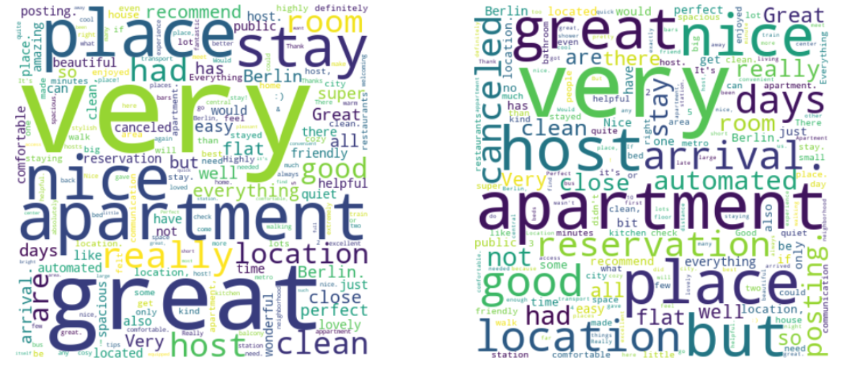
BEST 2000 SCORED REVIEWS
LEAST 2000 SCORED REVIEWS

Slide 14
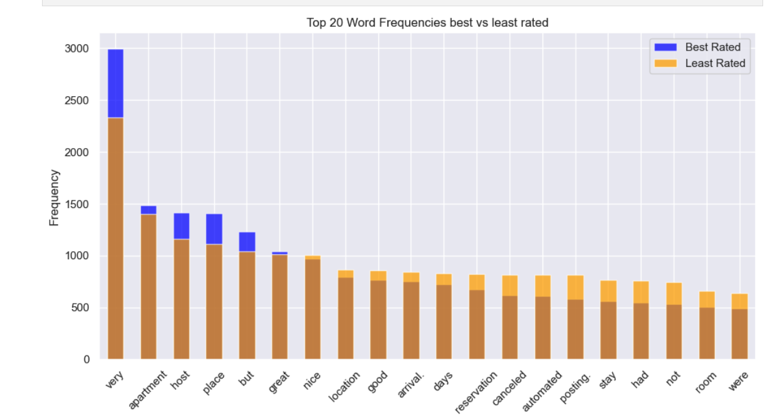
Best vs Least rated: most common words

Slide 15
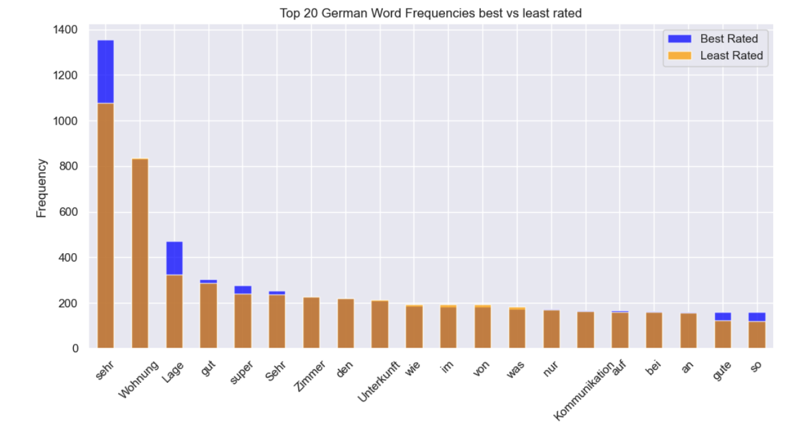
Best vs Least rated: most common words German

Slide 16
Conclusions
The variation in ratings both numerical and sentiment in this kind of data is extremely limited.
The numerical rating matches with the linguistics model.
Most rated accommodation reviews tend to have more intensifiers, and least rated accommodation reviews are distinguished by a slightly more proportion of neutral tone.
Further research: direct correlation between satisfaction scores and income.

Slide 17
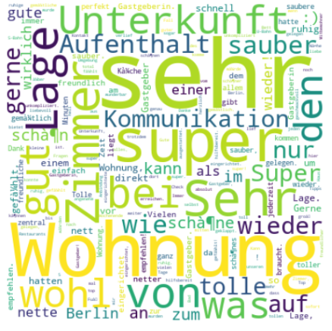
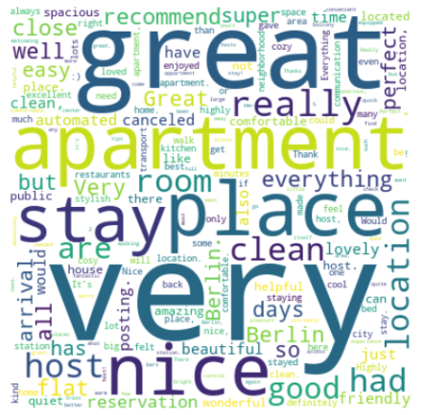
Questions?

